Slide 1
Module 02:
Tableau Comparison & Verification
Jeffrey Sirard ​
Utica University ​
DSC-563: Data Visualation​
Professor McCarthy​
October 28th, 2026​
Notes:
Module 02: Tableau Comparison & Verification + Graduate Extension
Collab URL: https://colab.research.google.com/drive/1bmKgFBiojkP8T30XcCcNvGV3XvvbYhUb?usp=sharing​
GitHub Repository URL: https://github.com/jasirard/DSC563
GitHub Profile URL: https://github.com/jasirard
GitHub Commit URL/ID: https://github.com/jasirard/DSC563/commit/e75727b612fb3238c30ee4a9c67d426c46eaebd0
Tableau Evidence URL: https://github.com/jasirard/DSC563/blob/main/Sirard%20Module%2002.twbx

Slide 2
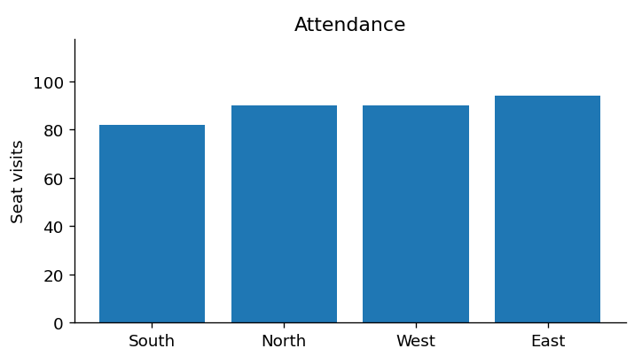
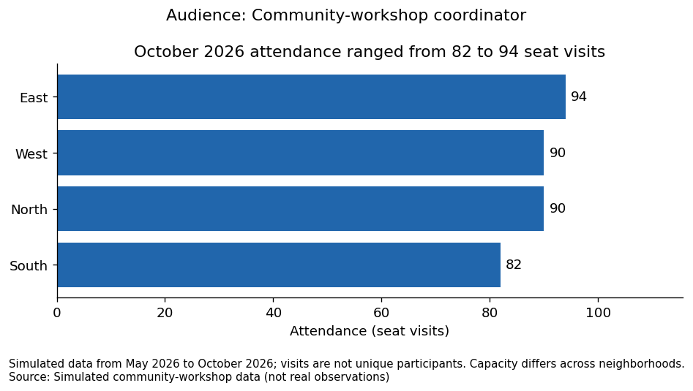
Background
Which neighborhoods show the highest workshop attendance?
Applied D.I.W.S. Framework
How does missing attendance data affect the comparison?
Evaluated incomplete information to mitigate bias
Data
Information
Wisdom
Story
D.I.W.S. Framework (Berengueres et al., 2019, pp. 17, 29)
Substituting values & bias (Schafer & Graham, 2002, pp. 152-154)
Notes:
In Module 1, we simulated community workshop data among four different neighborhoods, with the goal of answering two questions for workshop coordinators:
Which neighborhoods show the highest workshop attendance?
By applying the data, information, wisdom, storytelling framework, we improved the visualization to construct the narrative (Berengueres et al., 2019, pp. 17, 29)​.
The graduate extension evaluated how missing data affects the result.
We examined how a missing-month assumption changed the comparison between groups, and
How substituting arbitrary values for missing observations can introduce bias (Schafer & Graham, 2002, pp. 152-154).
For Module 2, we’ll use the same simulated data set for Tableau visualization.
We’ll also examine weighting, aggregation, and treatment of null values.

Slide 3
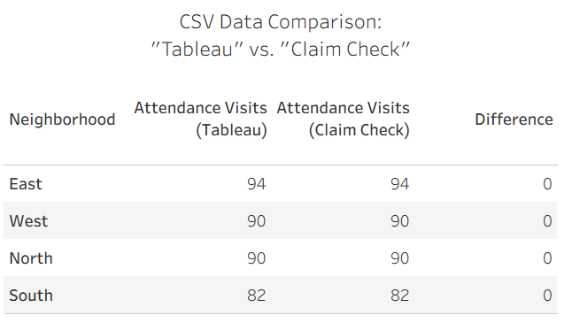
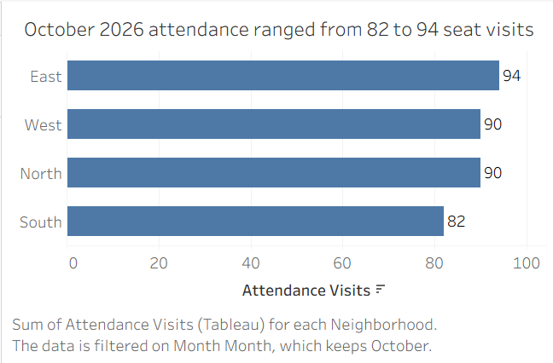
Visualization: python & Tableau
Python
Tableau
Faithful data interpretation (Tufte, 2007, p. 56)
Notes:
Here, I’ve created a Tableau version of the Python chart and verified accuracy using a numerical comparison, also within Tableau.
In data science, it is important to faithfully represent the underlying data and avoid transformations that distort interpretation (Tufte, 2007, p. 56).
The attendance values show that October 2026 attendance ranged from 82 to 94 seat visits, as is narrated in the title.
But this is just October. What about overall?

Slide 4
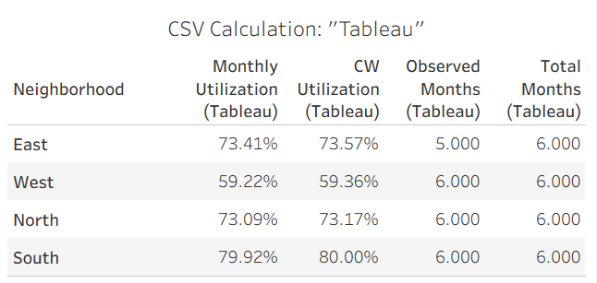
Utilization:
Weighting
Methods
Monthly Utilization (Mean)
  Each period receives equal weight
  Disregards workshop capacity
  How full was the average month?
Capacity-Weighted Utilization
  Each period has varying weight
  Directly related to workshop capacity
  How fully were available workshop seats used overall?
Rank | Monthly Utilization | Capacity-Weighted Utilization
1 | South | South
2 | East | East
3 | North | North
4 | West | West
Notes:
For the entire six-month period, the workshop coordinators want to know which neighborhoods show the highest workshop attendance?
Let’s talk about how to best approach this.
We could consider Monthly Utilization, where each month receives equal weight, regardless of workshop capacity.
Alternatively, Capacity-Weighted Utilization takes the total attendance and divides by the total capacity, so larger-capacity months receive greater weight;
In other words, this method gives greater influence to months with more available seats.
Capacity-weighting is generally preferred when capacity differs across observations,
because weighted averages account for the relative importance of each observation,
rather than treating all observations equally.
In this case, capacity-weighted utilization best answers the audience’s question.
However, we might as well perform both calculations.
The two measures differ by less than 1% for all neighborhoods.
And, in terms of ranking, South (80.0%) demonstrates the highest overall utilization, followed by East (73.6%), North (73.2%), and West (59.4%).
These rankings remain unchanged for both weighting methods due to the small differences between the two calculations.
The capacity-weighted rate is slightly lower because larger-capacity workshops tended to have somewhat lower utilization than smaller workshops.
Since capacity increases gradually across months and utilization remains relatively stable, the weighting effect is modest.
I should also mention that in this analysis, the missing month’s null value for the East neighborhood was excluded using a custom Tableau calculation. We’ll come back to this in a bit.

Slide 5
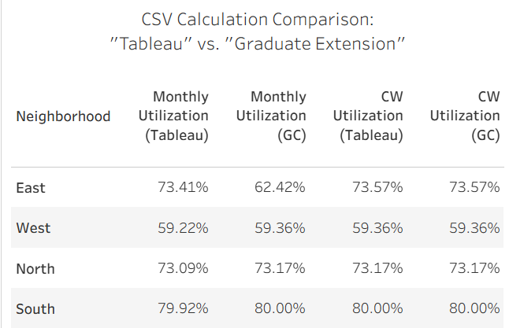
Aggregation:
Average vs. Sum
 | Tableau CSV | Python CSV
Data Layout | Totals for each month | Totals for entire period
Null Value | Included in data set; Ignored by custom Tableau calculation | Factored into total; Impossible to identify unobserved month
Aggregation | Able to find AVG of each month’s utilization | Restricted to finding AVG of entire period’s utilization
Aggregate measures (Healy & Moody, 2014, p. 5.13).
Notes:
Now, I’d like to talk about aggregation methods and its impact on this data comparison.
The Tableau CSV file contained data for each month’s attendance and observed capacity,
while the Python-simulated data only contained sum totals for the six-month period.
In the CSV comparison for capacity-weighted utilization, the values remains the same.
This makes sense, as the calculation involves observed capacity and excludes the null value.
In terms of monthly utilization, we once again see the minor differences for the West, North and South neighborhoods.
This has to do with aggregation; In the Python data, attendance and capacity were summed across the entire 6-month period, and then those totals produced a single average utilization.
The Tableau spreadsheet provides monthly values, so monthly averages could be calculated and then aggregated based on mean to provide a more precise result.
If we were to sum total the monthly averages, this would be misleading and just plain wrong.
For example, adding each month’s utilization percentage for the South neighborhood results in approximately 479.5%.
This is not meaningful since utilization cannot exceed 100%.
This is a good example of how aggregate measures should accurately reflect the phenomenon being studied;
Otherwise, inappropriate summarization can lead decision-makers to draw incorrect conclusions (Healy & Moody, 2014, p. 5.13).
Ok, that’s great. But what is happening over in the East neighborhood? Let’s zoom in.

Slide 6
Treatment of
Null Values
Which method is more truthful?
Missing value = attendance was not recorded
Zero value = nobody attended
Capacity-Weighted Utilization is equal among both data sets
Both calculations consider observed capacity and recorded attendance
This effectively treats the null value as missing
Null = Missing (ignore)
Null = 0
5 / 6 months = 0.833
= 83.3%
Effective data visualization transforms complex datasets into information that promotes understanding and insight (McCandless, 2010).
Notes:
East contains one missing attendance value, seen in the blue box.
5 out of 6 months were observed, meaning that East had approximately 83.3% data coverage.
This missing, or null value, can either be treated as zero or be removed from the calculation entirely.
When the null value is treated as zero attendance, as seen in the red box, East's utilization drops by about 12%.
Unless there is evidence that attendance was actually zero, this assumption biases utilization downward and understates performance.
So, ignoring the null value, like we did in the green box, is a better representation of utilization.
Remember when I said earlier that I excluded the null value using a custom Tableau calculation?
That one simple change transformed complexity into information that promotes understanding and insight rather than confusion (McCandless, 2010).

Slide 7
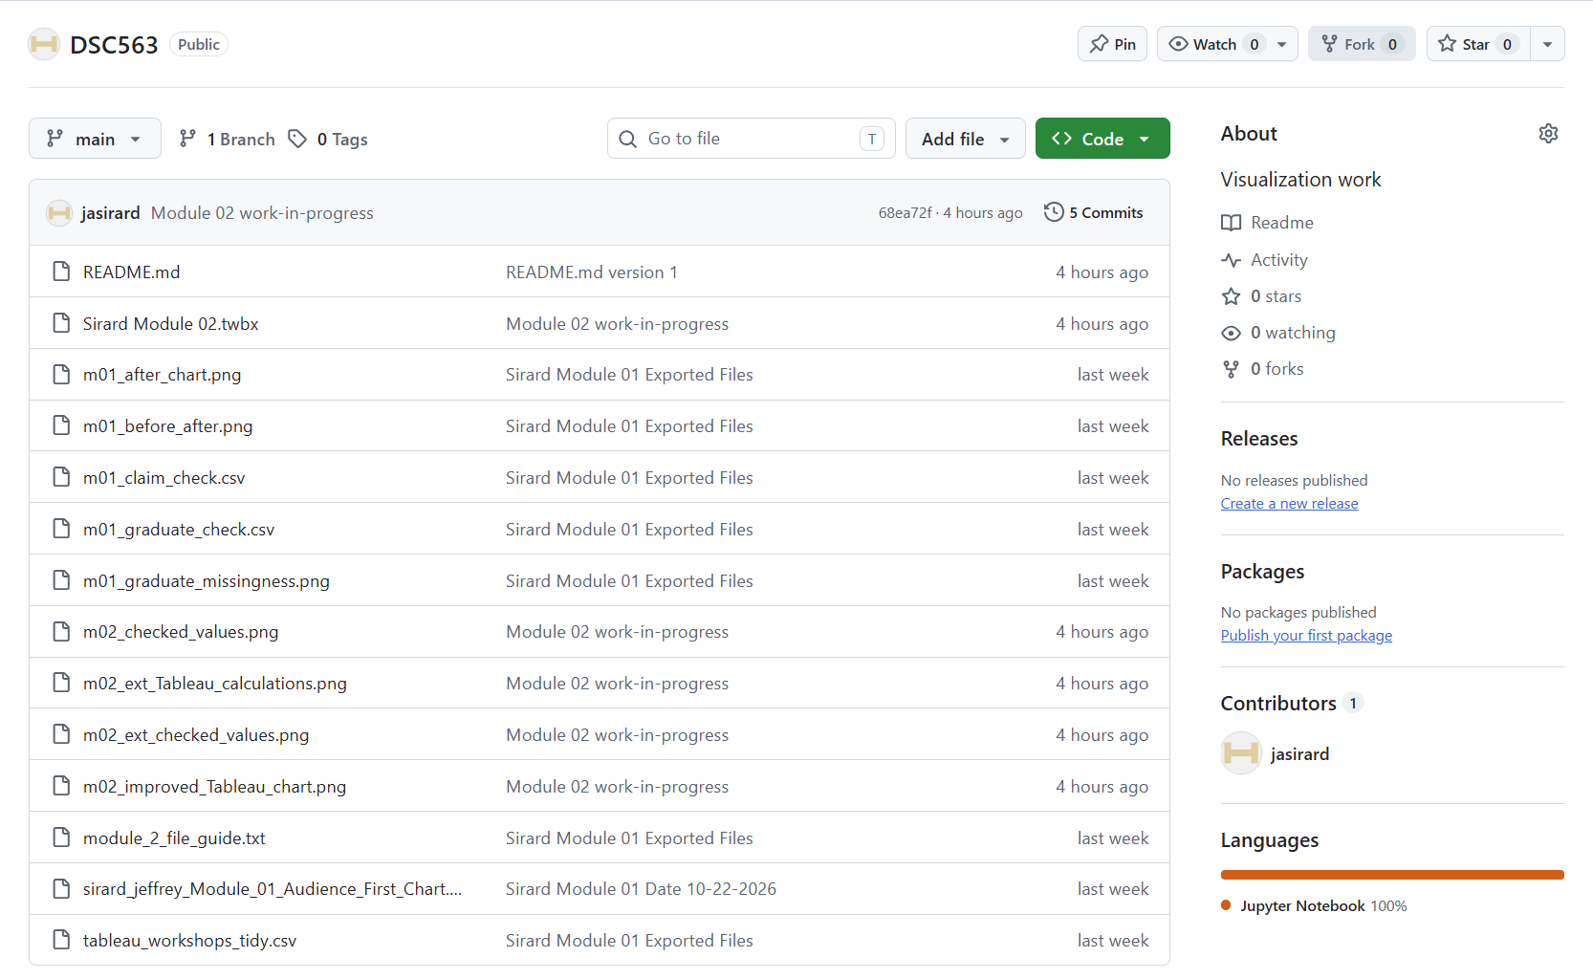
Github
Notes:
Here is a brief overview of my Github page.

Slide 8
References
Required:
      Berengueres, J., Sandell, M., & Fenwick, A. (2019). Introduction to data visualization & storytelling: A guide for the data scientist (2nd ed.).​
      McCandless, D. (2010, July). The beauty of data visualization [TED Talk]. TED Conferences. https://www.ted.com/talks/david_mccandless_the_beauty_of_data_visualization
      Tufte, E. R. (2007). The visual display of quantitative information (2nd ed.). Graphics Press.
External:
      Healy, K., & Moody, J. (2014). Data visualization in sociology. Annual Review of Sociology, 40, 105-128. https://doi.org/10.1146/annurev-soc-071312-145551
      Schafer, J. L., & Graham, J. W. (2002). Missing data: Our view of the state of the art. Psychological Methods, 7(2). https://doi.org/10.1037/1082-989X.7.2.147​
AI Disclosure:
  Grammarly was used to assist in writing the script.​
  PowerPoint Designer was used to assist with slide visuals.​
Notes:
That’s all for now.
Here are my references and AI disclosure.
Thank you!

